Slide 1
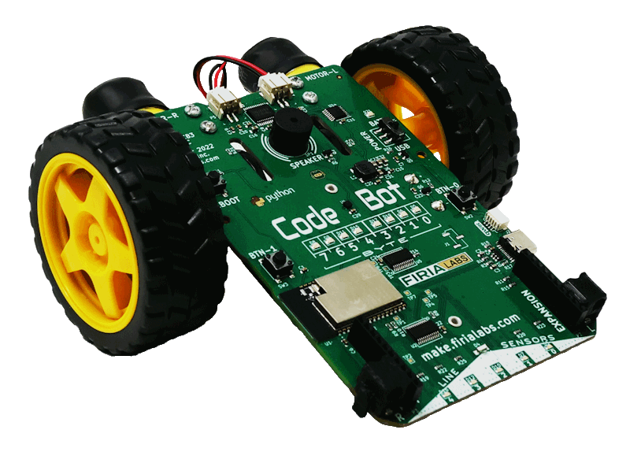
CodeBot Unit 2 Remix
Create your own project based on Mission 4 and 5

Slide 2

Time for a project remix!
A remix can be:
A new program created by adding new code to a program you already created
You can combine parts of two or more programs in a remix
Use a similar idea in a different way

Slide 3
Project Remix
Creating a remix will let you:
Improve your skills and practice the concepts from the mission.
Be creative.
Remember code from earlier programs and missions.
Work with other students.
Design an original program and write the code all on your own.

Slide 4
Step #1
Review Mission 4 and 5
Open your programs from Mission 4 and 5
  SweepLEDs
  LineSense
DO THIS:
Fill out the information in the Planning Guide for Step 1

Slide 5
Step #2
Brainstorm ideas
Read through the mission extension ideas.
Read through remix suggestions.
You can use any of these ideas or come up with your own.

Slide 6
Step #2 Remix Ideas
Mission 4 Animatronics Extensions
Make the animation longer by having the CodeBot do more things.
Wait for more than 5 people before triggering the animation. You may need to count in binary. Can you use a random number of guests each time?
Add code so when a button is pressed, the CodeBot returns to its original position.

Slide 7
Step #2 Remix Ideas
Mission 5 Fence Patrol Extensions
Add a button for stopping the CodeBot.
Use one button for dark on light readings, and the other button for light on dark readings.
Use one button for a lot of light in the room, and the other button for a darker setting.
Add sounds to the code so the ‘bot gives a specific auditory announcement when it hits a line.
Use random numbers – it could be for speed, amount of turn, etc.

Slide 8
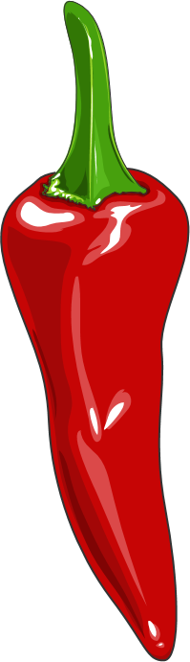
Step #2 Remix Ideas
Mild
Add sounds and actions to the fence patrol mission.
Medium
Combine Mission 4 and Mission 5 using the buttons: press 0 for animatronics and 1 for fence patrol.

Slide 9
Step #2 Remix Ideas
Medium
After the animatronics, let CodeBot wander around the stage greeting the guests, but staying on the stage (and within bounds).
Spicy
Add a line detection function to the animatronics program so it doesn’t “fall off the stage” during any part of the animation.

Slide 10
Step #2
Brainstorm ideas
Read through remix suggestions
Use the suggestions –or–
Use your creativity to come up with your own idea for a project
Decide with your partner what project you will do
DO THIS:
Fill out the information in the Planning Guide for Step #2

Slide 11
Step #3
Make a plan
What variables will you need? What will you use them for?
What will you program the buttons to do?
What will you use the user LEDs and line sensor LEDs for?
Will you use the speaker? If so, when?
How will you incorporate the line sensors?
What are some functions you can define and use? Will they need parameters?

Slide 12
Step #3
Make a plan
DO THIS:
Fill out the information in the Planning Guide for Step #3
  Add to the Planning Guide with more information, as needed.
  NOTE: You can modify your plan as you begin to program. You may come across more functions to create, LED uses, and more as you go.
  You do not need to revise Step 3 while you work.

Slide 13
Step #3
Make a plan
DO THIS:
Use a piece of paper to write an algorithm for your project:
  What happens first?
  What happens next?
This algorithm will help you get started.
  What do you need to import?
  What variables will you define at the beginning of your code?
  Are there functions you can start with?
  What happens first in the main program?
  What will happen in the button presses?

Slide 14

Step #4
Code your project
IMPORTANT: In CodeSpace, go to the sandbox
Start a new file and give it a descriptive name (Remix2)
You can leave other programs open and use them as a guide
Import your modules
Define your variables
Write functions near the top of your code
Write function calls and other instructions in the main program
Write your code a little bit at a time, testing frequently

Slide 15
Step #4
Stop and test frequently!
Don’t try to write all the code at one time
Think about the steps:
  Just get one thing to work, then move on
  Step by step!
Mistakes happen, so find them early
Type just a few lines of code and then run the program
If there is an error, fix it before continuing
Use your other programs and classmates for help

Slide 16
Step #4
Documentation!
Make sure your code is readable by adding blank lines
Add comments to sections of your code that explain what they do

Slide 17
Step #5
Get feedback and Revise
Show your code to other students.
What do they think? Have them fill out the feedback form on your Planning Guide.
The Planning Guide has space for two people to give feedback. The feedback can come from two peers or one peer and yourself.
Use the peer reviews to modify your code and make your project even better

Slide 18

And now you have your own remix!
Congratulations!
By completing this remix you have:
learned more about programming
practiced the skills and concepts from the missions
been thinking! And problem solving and much more!

Slide 19

Mission Reflection
Wow! Great job!
Share your project with your friends!
Run projects from other students
Complete the Post-Remix Reflection in the Planning Guide

